Slide 1
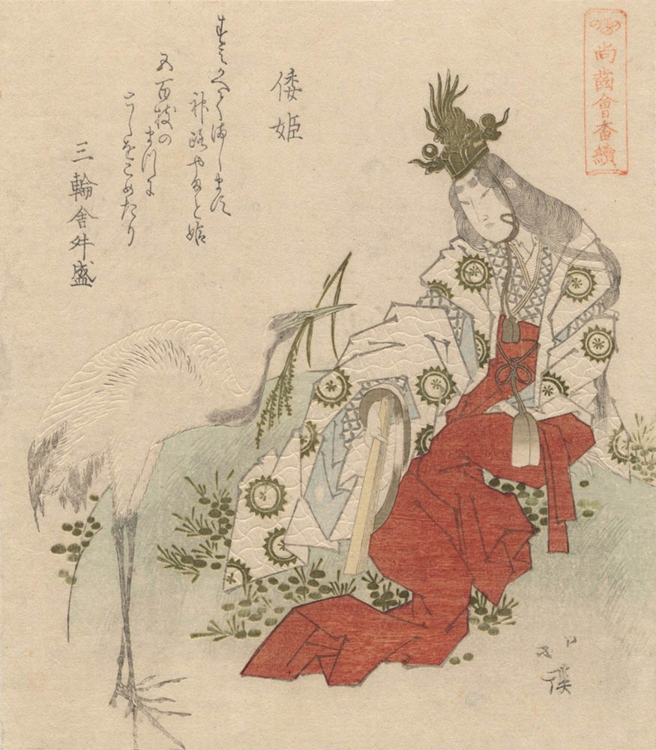
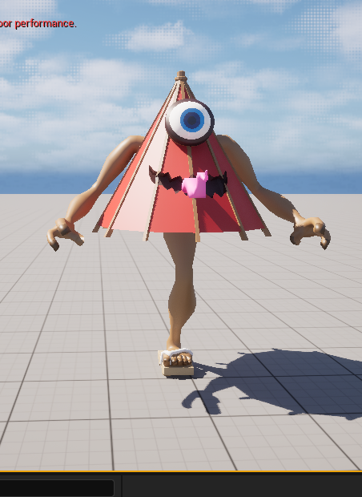
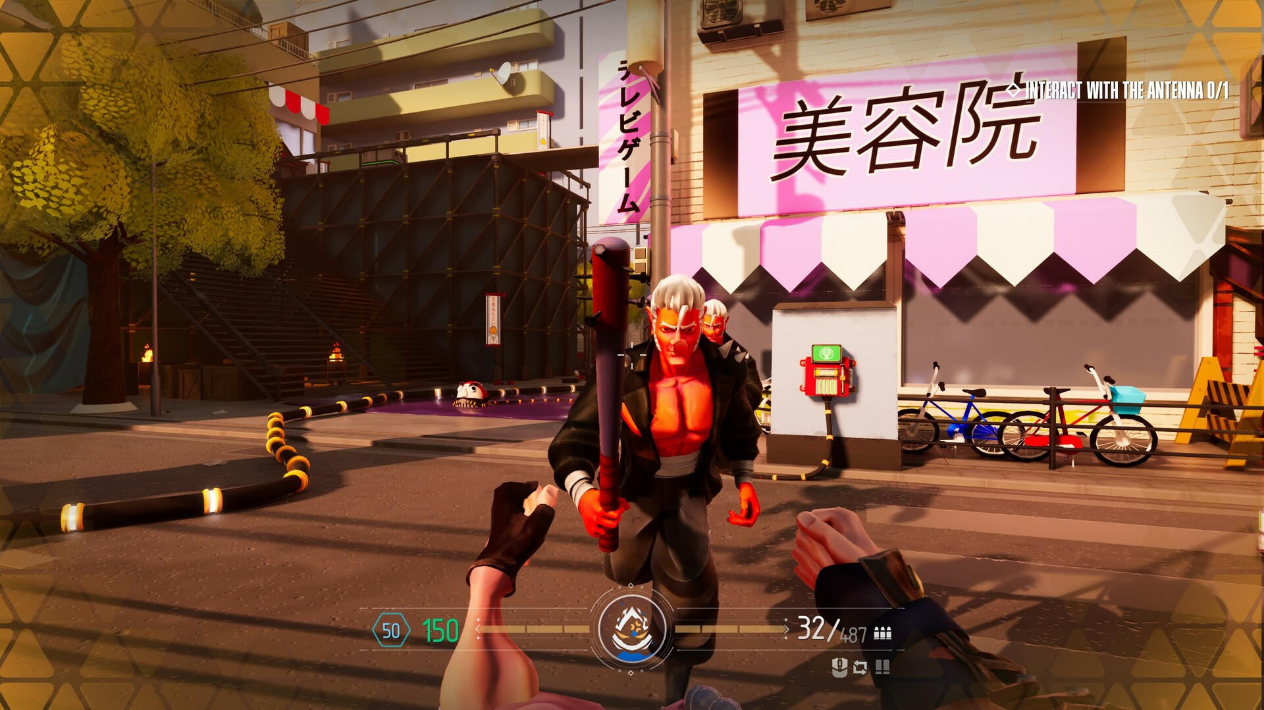
Yamatohime Sacred Quest
Key Features:
First-person combat.
Waves of evil yokai enemies.
Gifted buffs from good Yokai granting unique abilities. Like: Health regen.
Unlockable divine flame powers from goddess Amaterasu Ōmikami. : Meaning Damage Buff or Flame related Abilities.
Unlockable Weapons. Like: Gohei, and Hama Yumi (bow).
Lore:
Gameplay:
You are playing as Princess Yamatohime-no-Mikoto, defending and reglorify an abandoned shrine from waves of evil yokai using the legendary Kusanagi no Tsurugi and divine powers granted to her by Amaterasu Ōmikami (Shinto goddess of the Sun).
My proposed gameplay is a round-based first-person action game where players are to defend an abandoned shrine from evil yokai. The setting will be in the shrine's yard, where evil yokai will emerge from the map's edges and make their way toward the shrine.
Sample of the ideal game play
Example of a Yokai
(Named Kasa-obake)
WANTED: Yokai Uprising.
Yamatohime-no-Mikoto

